Slide 1
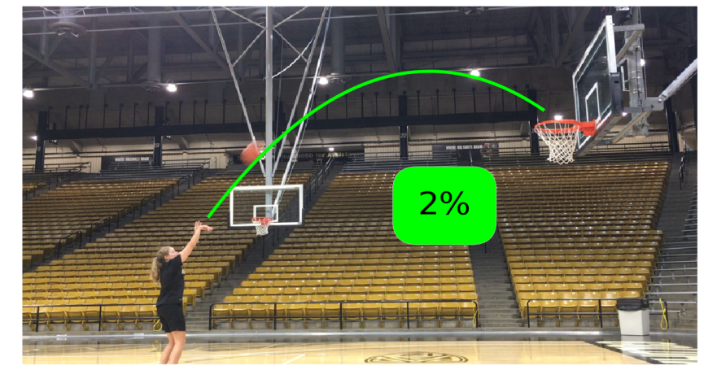
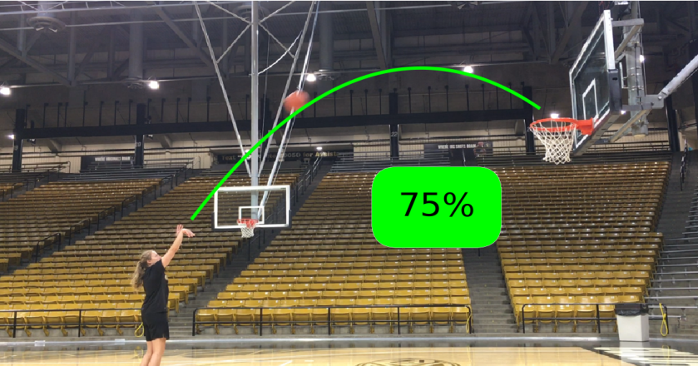
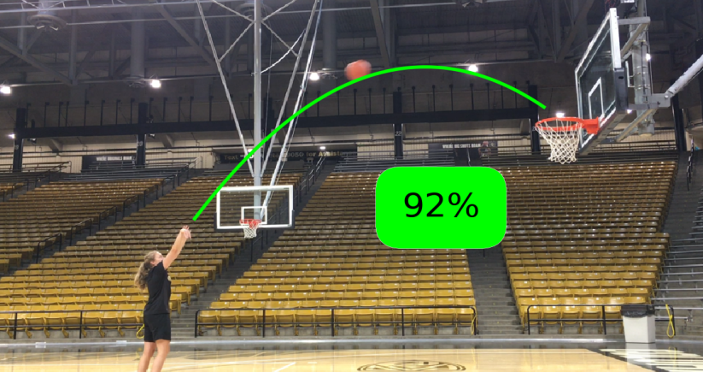
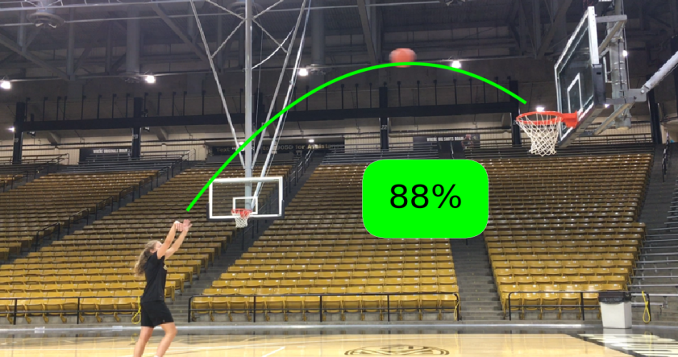
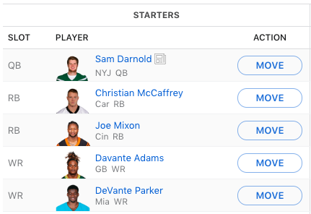
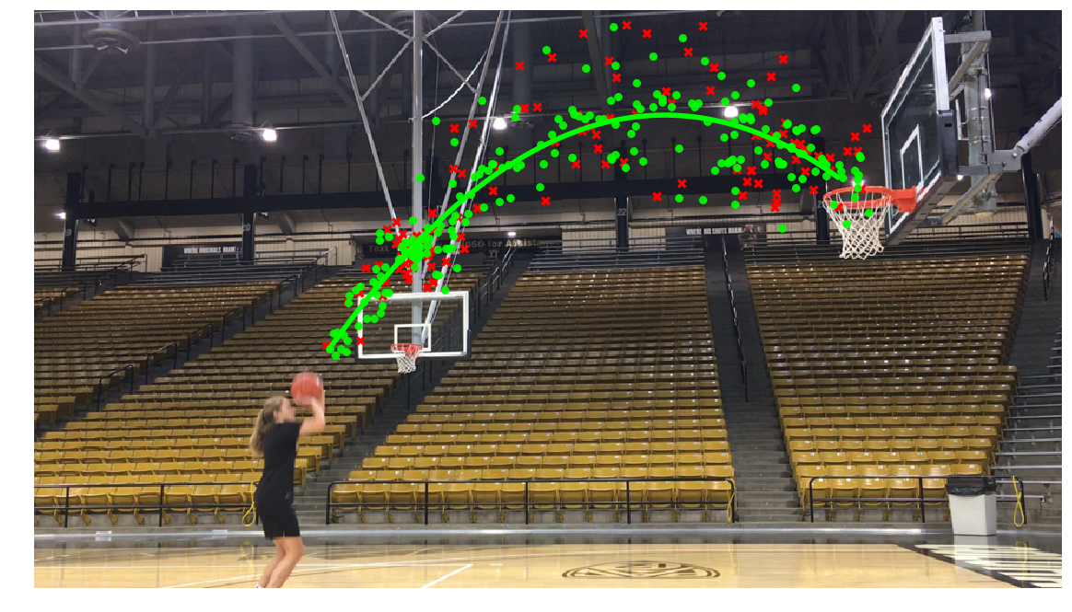

Predicting Fantasy Football Points by NFL Position
Scott Baker, Chloe Bruce, Nick Varberg
Dr. Chenhao Tan, CSCI 5622 Fall 2019
Introduction
Models
Prediction
Millions of fantasy football managers set their starting lineups each week in the hopes to score more points than their opponent. How do managers decide who to start? Many make naïve decisions by starting whoever scored best in the previous week. We design models to predict fantasy football points scored by each player each week so that managers can make more informed decisions.
We implemented the following models with rationale:
Naïve baseline: Predict each fantasy score as the player’s previous fantasy score. This is essentially how naïve fantasy football managers make starting lineup decisions.
ARMA.
Linear Regression. We implement linear regression because we believe many of our features have linear correlation with fantasy points scored. For example, we think opponent’s defensive yards allowed per play will have linear correlation to a quarterback’s fantasy points.
Random Forest. We implement random forest because we want the power of an ensemble method and the non-overfitting character of the random forest.
One application of this model is to predict Leonard’s mid-shot shooting percentage based on previous data [1].
Remarks
Critical elements of this process:
Engineering predictive offensive and defensive statistics
Feature Engineering
The most important part of our project was engineering predictive offensive and defensive statistics. We engineered 10 features:
2 involved player characteristics: the number of NFL games played in and their draft pick
5 involved team statistics about passing, rushing, and receiving attempts and quality
2 involved opponent defense strength
1 is the exponentially weighted moving average of each player’s previous fantasy scores (the feature we hypothesized as most predictive)
References
[1] “Kennedy Leonard.” University of Colorado Athletics, cubuffs.com/roster.aspx?rp_id=11879.
[2] Forsyth, David A., and Jean Ponce. Computer Vision: A Modern Approach. 2nd ed., Pearson Education, 2015.
[3] Faraway, Julian James. Linear Models with R. Chapman & Hall/CRC, 2015.
Acknowledgements
Kennedy Leonard for helping us obtain high quality input video
Tristan Neate for his contributions to the computer vision algorithms
Elliott Tung for his basketball advice with respect to explanation
The highest scoring cluster center coordinate locations were recorded for 5-8 frames per video.

